Slide 1



Sales & Revenue Performance Analysis
Author: Bolarin Esan

Slide 2

CONTENTS
Multi-Country Overview
Executive Summary
Top Countries by Revenue
Top 5 Manufacturers by Revenue
Top 10 Products by Revenue
Total Revenue by Category
% of Urban Revenue and Uncategorized
Top Manufacturers by Number of Products
Yearly Revenue Trend
Revenue Trend by Year and Month

Slide 3


1. Multi-Country Overview
2014 to 2021

Slide 4

2. Executive Summary
The business operates on a significant scale, generating $2.84 billion in total revenue across five countries, 146,000 cities, 14 manufacturer, and over 2,412 products. Performance remains robust, with $471.4 million delivered year-to-date indicating sustained growth momentum.
However, revenue distribution is uneven; key markets like the US and Australia drive the bulk of revenue, while other countries contribute less. One manufacturer accounts for over $1.25 billion, creating dependency, and a small group of high-performing products drives a large revenue share.
Urban revenue accounts for only 4.04% of total sales, suggesting either untapped potential or a need to redefine urban markets. Additionally, 95.21% of revenue is considered uncategorized, limiting product mix visibility and highlighting a need for better data governance.
The business shows strong growth and has opportunities to reduce reliance on key markets and partners, improve data quality, and drive growth via focused geographic, supplier, and product strategies.

Slide 5

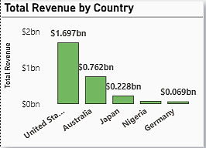
3. Top Countries by Revenue
The bar chart shows that revenue is highly concentrated in the United States with about 59% of the total revenue. This concentration highlights a geographic dependency risk, as overall performance is heavily influenced by a limited number of locations.
However, the chart also reveals that the lower-performing countries like Nigeria and Germany may represent a clear expansion opportunity, where strategic investment and market development could diversify and grow revenue.

Slide 6

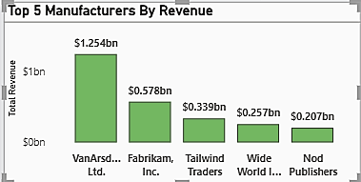
4. Top 5 Manufacturers by Revenue
The analysis shows that revenue is concentrated among a small group of manufacturers out of the 14 manufacturers, which comprises VanArsdel, Ltd., Fabrikam, Inc., Tailwind Traders, Wide World Importers, and Nod Publishers dominating the top five contributors generating 75% of total revenue.
This level of concentration indicates a dependency on key manufacturing partners, which supports strong performance but also introduces supplier risk. Strengthening strategic partnerships with high-performing manufacturers while gradually diversifying the supplier base can help sustain growth and reduce dependency risk.

Slide 7
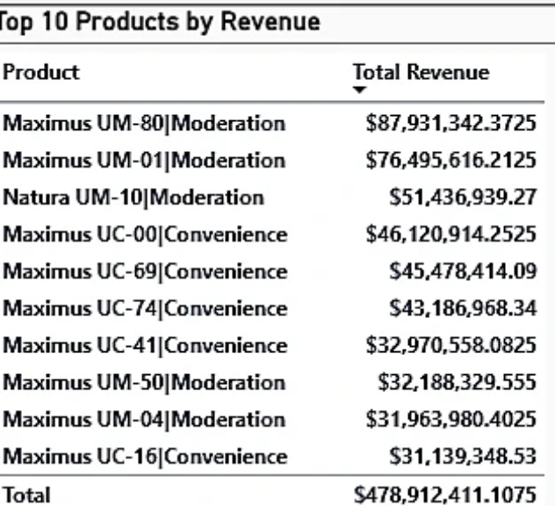
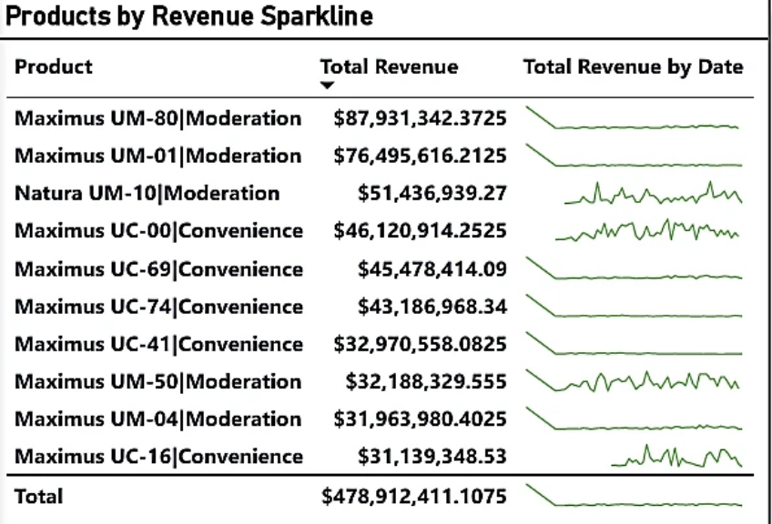
5. Top 10 Products by Revenue
The top 10 products generate a combined revenue of approximately $479M, indicating that a relatively small portion of the product portfolio drives a significant share of overall revenue. The leading product, Maximus UM-80 (Moderation), alone contributes nearly $88M, clearly standing out as the top performer.
The table highlights the 10 highest-revenue products, revealing that less than 1% of the total number of products accounts for 16% of the total revenue. Products in the Moderation category appear frequently among the top revenue contributors, including four of the top five products. This suggests that Moderation products are a core revenue pillar and a key area of customer demand.
Products with smooth, stable sparklines show they are consistent revenue contributors and form the core of the product portfolio.

Slide 8
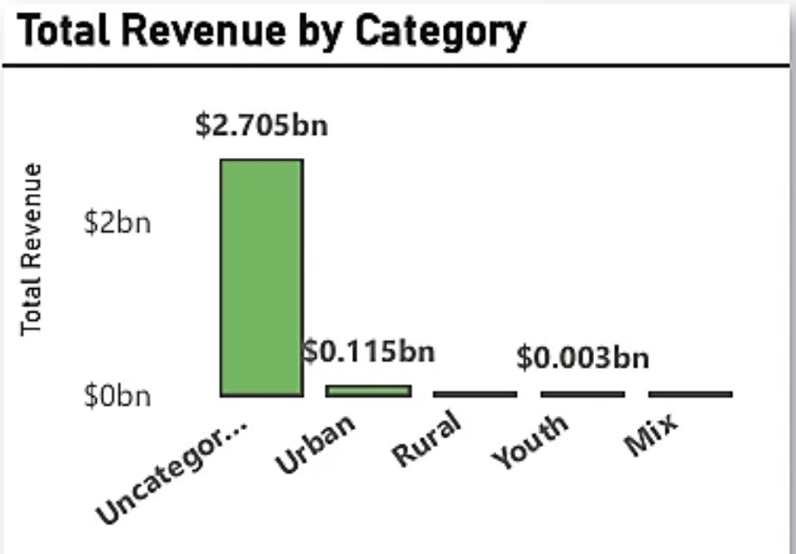
6. Total Revenue by Category
The vast majority of total revenue — approximately $2.7bn — falls under the Uncategorized category. This represents over 95% of total revenue, significantly limiting visibility into true product and market mix.
Urban revenue contributes approximately $0.115bn, which is a small fraction of overall revenue compared to the uncategorized segment. This suggests either limited urban market penetration or that a significant portion of urban sales was not properly classified as revealed in the data provided.
The dominance of the uncategorized segment strongly indicates a data classification gap, rather than a true lack of diversity in customer or market segments.

Slide 9
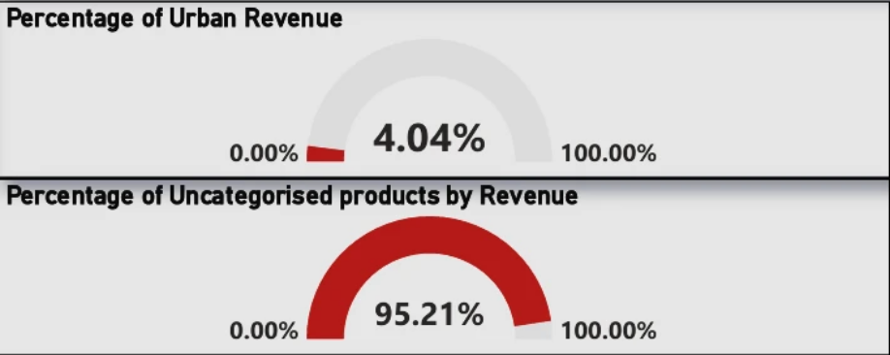
7. % of Urban Revenue and Uncategorized
The combination of low urban revenue and extremely high uncategorized revenue points to data classification issues, rather than purely market-driven outcomes. As a result, some revenue may be misrepresented or hidden within broad, non-informative categories.

Slide 10
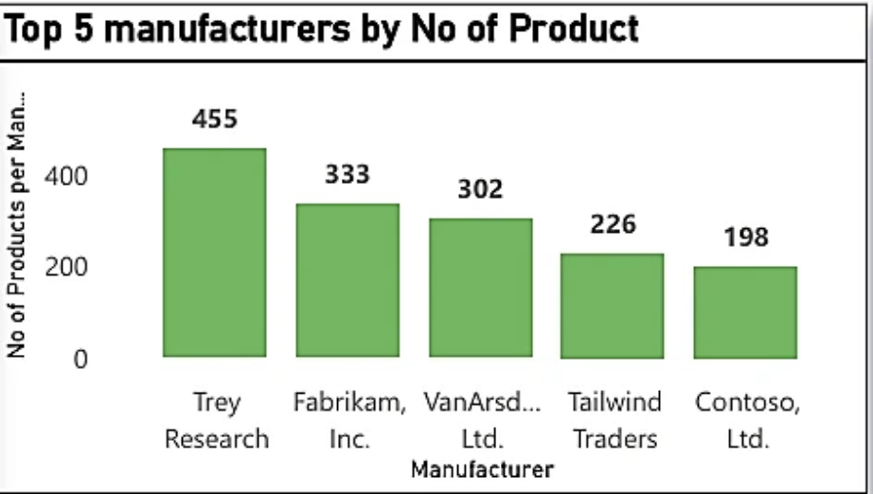
8. Top Manufacturers by Number of Products
There is a clear spread in portfolio size among the top manufacturers. Trey Research leads significantly with 455 products, well ahead of other manufacturers, indicating a broad and diversified product offering.
Fabrikam, Inc. (333 products) and VanArsdel Ltd. (302 products) have sizeable portfolios, suggesting competitive depth, though notably smaller than the market leader. Tailwind Traders (226 products) and Contoso Ltd. (198 products) operate with comparatively leaner product ranges, which may indicate a focus on fewer, higher-impact products or narrower market positioning.

Slide 11


9. Yearly Revenue Trend
Revenue shows a consistent upward trajectory from 2014 to 2021, growing from approximately $206million bn to $471million. This reflects strong and sustained business expansion over the eight-year period.
The most pronounced growth occurs between 2014 and 2017, where revenue increases rapidly. From 2017 onwards, growth continues at a more measured and stable pace, indicating a transition from rapid expansion to maturity.

Slide 12
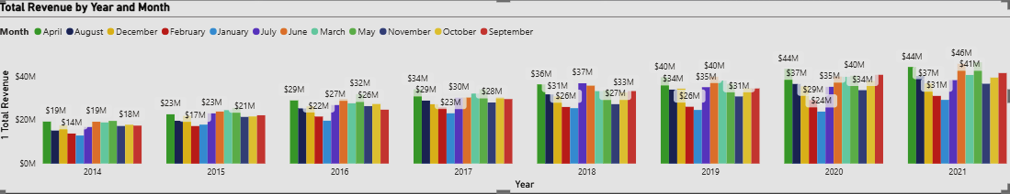
10. Revenue Trend by Year and Month
Across the eight-year period (2014–2021), total revenue shows a steady upward movement. Annual monthly values rise from $14M–$23M in the early years to $35M–$46M by 2021, indicating sustained business growth rather than short-term spikes.

Slide 13

Conclusion
This analysis demonstrates a business operating at significant scale, with $2.84bn in total revenue generated across multiple countries, manufacturers, and products, supported by consistent and sustained growth from 2014 to 2021 . Revenue performance is strong and resilient, with no year-on-year decline, indicating a stable and mature business
However, the analysis also reveals high concentration risks, with revenue heavily dependent on a small number of countries, manufacturers, and products. While this concentration has driven strong performance to date, it introduces exposure to geographic, supplier, and portfolio risks if market conditions change.
In addition, data quality limitations—particularly the high proportion of uncategorised revenue and low recorded urban contribution—currently constrain deeper insight into product mix and market behaviour. Addressing these gaps represents a significant opportunity to improve decision-making, unlock hidden growth potential, and better target future investments.
Overall, the business is well-positioned for continued growth. By diversifying revenue sources, strengthening data governance, and strategically expanding into underpenetrated markets and product segments, the organisation can reduce risk and sustain long-term performance

Slide 14
Thank You

